Slide 1


Financial Inclusion – focus on the UK
A case for Islamic Microfinance in the UK
Rahal Ahmed
Notes:
Introduce topic to be – covered – Financial inclusion – with a focus on the UK and whether there is a viable case for Islamic microfinance.

Slide 2
Today's discussion
Financial Inclusion – Definition and Characterisation
  Role of Microfinance (Islamic)
Financial Inclusion in UK
Impact of Financial Inclusion on Muslims in UK
Forms of intervention to address Financial Inclusion needs – CDFI

Slide 3
DEFINITION AND CHARACTERISATION
Financial Inclusion -Promotes economic growth and development. It’s about ensuring everyone has equal access to at least the basic financial services they need in order to live a stable and secure life.
Individuals and businesses having access to and use affordable financial products and services that meet their needs, which are delivered in a responsible and sustainable way. World Bank
Financial inclusion is essential for economic growth
Financial inclusion reduces poverty
Promotes Social equality
Notes:
To ensure that we are all on the same page we are going to have a quick glance at the definition and the characteristics/characterisation of financial inclusion and what we actually mean by using this term.
Definition
Financial Inclusion - is the notion of individuals and businesses having access to and use of affordable financial products and services that meet their needs, which are delivered in a responsible and sustainable way.
This typically refers to payment services, savings, access credit facilities and insurance.
World bank definition
Financial inclusion promotes economic growth: by providing individuals and businesses with access to credit, insurance, and other financial products, small and micro businesses can expand and create employment opportunities, which in turn can help to reduce poverty.
Financial inclusion can help to promote social inclusion by providing underserved communities with access to financial services who often face various forms of economic marginalisation.

Slide 4
Financial Exclusion
Refers to individuals/communities that are unable to access basic financial services such as savings accounts, loans, cashless transactions, credit, and other traditional banking services
Why Excluded:
  Excluded due to socio-economic status;
  unable to meet the requirements of a formal banking institution;
  Deemed uneconomical to serve or too difficult to reach
  low credit score;
  access issues (physical/digital);
  lack of suitable products (shariah compliant);
  self exclusion/lack of trust;
  inability to access products via the preferred channel
Poverty Premium – Low income individuals face additional cost/extra expenses when conducting transactions, costs that are typically not borne by those with full access to financial services.
Premium could amount to approximately £1,300 a year per person.
EXCLUSION IMPACT
Limited or no access to Digital technology
Unable to meet their basic consumption needs
Falling into debt trap
Inability to build future resilience
Managing irregular cash flow
Inability to Access wider resources
Notes:
In recent years, the term “financial inclusion” has become more prevalent in our everyday vocabulary. Around the world, countries and organizations are homing in on how they can foster a culture of financial inclusion.
However, with all of the focus on financial inclusion, far less people really talk about or refer to financial exclusion. And given that ‘you can’t have one without the other’, maybe looking at it from an financial exclusion perspective it will shed light on the real issue and their impact.
Slide Definition - Financial exclusion refers to individuals and communities without access to common financial services. These can include savings accounts, loans, overdraft facilities, credit, and other basic banking services.
Why are people/business Excluded:
Excluded due to socio-economic status (unemployed/low income/limited education);
unable to meet the requirements of a formal banking institution;
Deemed uneconomical and difficult to reach;
Effected by low/no credit score;
Have access issues (physical/digital);
There maybe a lack of suitable products (shariah compliant);
self exclusion/lack of trust;
inability to access products via the preferred channel
Click for image
Financial exclusion therefore can have a significant impact on someone’s life, making it difficult to manage bills, save money, or access credit.
This in turn means they are unlikely to be able to improve their financial status over time and, without proper intervention…, # Being unable to access financial services can contribute to social exclusion, poverty and inequality. #
That’s because a lack of financial resource means individuals tend to face difficulties progressing towards a healthier, more sustainable and better quality of life.
Furthermore, Without access to useful affordable financial products and services that caters for the needs, it can prevent people from: Meeting their basic consumption needs, such as nutritious food, clean water, housing, and healthcare;
Managing irregular cash flow; Protecting themselves in times of crisis;
Accessing wider resources.
Poverty premium:
There’s also something called the poverty premium, which refers to the extra costs that people with low incomes pay for basic/essential services, compared to those with higher incomes. For example, the following can often be more expensive pay-as-you-go mobile phone contracts, utility payments (prepayment meters), high cost credit and insurance.
Estimates reveal that the poverty premium could amount to approximately £1,300 a year per person.
So we have looked at the definition of both inclusion and exclusion, the former being the normative perspective of what an ideal reality ought to be and the growing concern of financial exclusion –Which is more of empirical definition that captures the reality of market failure (where there exists inefficient distribution of products and services and indeed wealth)

Slide 5
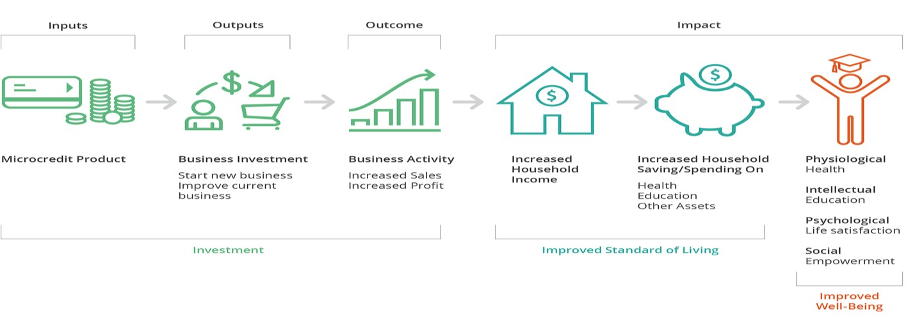
The role of Microfinance
Microfinance: Informal (non-bank) financial services for those who are financially excluded including unsecured lending, microsavings, micro insurance, money transfer & payment service.
Islamic microfinance: The confluence of financial inclusion with Islamic finance principles instilled in the products and services (prohibition of interest, excessive risk, ambiguity) although less than 1% of total global microfinance is Sharia-compliant
Notes:
so where the market does not provide adequate access to financial services certain segments for the community…what is the solution?
This leads us to the final definition which is microfinance – and its role.
Role of Microfinance
Microfinance is in its essence is one of the main forms of intervention that seeks to provide a solution addressing the issues pertaining to financial exclusion.
Definition in its simplest terms is Microfinance refers to informal (non bank) financial services provided to low-income individuals or groups who are typically excluded from traditional banking
Most microfinance institutions focus on offering credit in the form of small working capital loans, sometimes called microloans or microcredit.
The diagram depics the process and I guess in some sense the ‘theory of change’ – where there is a investment element, a realised
expected output which has a positive impact on the household, which in turn improves social well being.
So the goal of microfinance (particularly Islamic microfinance) in its purest sense is to be a welfare enhancing form of intervention which promotes the notion of a fairer more inclusive economy.
Islamic microfinance: The convergence of financial inclusion with Islamic finance principles (prohibition of interest, excessive risk, ambiguity, and promoting partnership based products) although less than 1% of total global microfinance is Sharia-compliant.
Common products include Qard hassan, Murabaha, bi salam
The Global Market size of MF is estimated to be around $260 billion with this projected to reach around $600 billion by 3030
Now that I have we explored some of the definitions, some of the causes there impacts and interventions though microfinance.
We will now take a high level snapshot of financial inclusion in the UK.

Slide 6

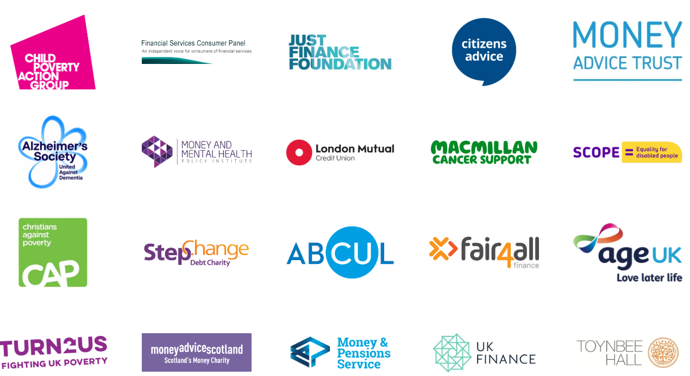
Financial Inclusion in UK
UK population is around 69 million.
How many are considered financial excluded?
  13 million people in the UK face financial exclusion (19%)
  8.9 million of the UK adult population (15%)
UK Global ranking in Financial exclusion?
  11th dropped from 7th out of 41 markets
22% of all adults have less than £100 savings
16% are borrowing to pay for essentials because they run out of money
1 million do not have bank account
3 million (16-24) economically inactive (NEET)
  Education levels declined 16th from 6th
FI has improved Globally contrary to UK’s decline
UK Government policy goal to address financial and digital exclusion.
Appointment of Financial Inclusion Commission
A recognition by the regulator for the need to support FI (FCA)
A very proactive lobbying/advocacy group
Notes:
Indeed FI has traditionally been associated to a market failure phenomenon resonating in the more developing regions namely the global south.
In the UK FI has gained significant traction in recent times, policy makers, regulators have acknowledged that this phenomenon is no longer just unique to the global south although lot of work still remains to be done at a policy level.
Financial exclusion in the UK is certainly becoming more and more prevalent. Following the 2008 financial crisis and then covid, coupled with the increasing cost of living, welfare cuts, inflation has given rise to an increasing number of the population who struggle to access basic finance therefore deemed financially excluded.,
…alarming perhaps when you consider the UK’s (London) position as one of the financial districts of the world.
According to recent government stats the uk population is around 69 million… any guesses as how many is considered financial excluded?
13 million people in the UK face financial exclusion, according to The Inclusion Foundation this means they struggle to access affordable and fair financial services.
in 2023 a report by the Money and Pensions Service indicated that 15% of the UK adult population, approximately 9 million adults, are considered financially excluded.
The Principle financial group and Centre of economic and business research have developed an index referred to as The global financial inclusion index which is measures how governments, employers, and financial systems promote financial inclusion in more than 40 markets.
Any guesses where the UK ranks?
Global FI index ranking
This decline is partly attributed to a perceived "backward-looking" approach by the UK gov compared to other markets investing more in FI/fintech/digital inclusion,
Lets have a look at some of the data…
22% of all adults have less than £100 savings
16% are borrowing to pay for essentials because they run out of money
1 million do not have bank account.
There is over 3 million (16-24) who are not working and economically inactive (NEET)
Uk’s education levels declined six places to 16th.
Unemployment is up from 4.2% to 4.8% that’s around 1.7million
But perhaps more concerning is the fact that while the U.K. has fallen in the rankings, financial inclusion has actually improved globally for the second consecutive year, with all regions seeing advancements. Indeed, 32 out of the 41 markets (or 78%) saw their scores for financial inclusion increase year over year.
Now whilst these stats illustrate a grim financial Inclusion reality in the UK. There are some positive signs.
In recent times the need to recognise the importance of FI and indeed support its development have been well received by the government, namely due to the very progressive and proactive lobbying and advocacy groups.
The appointment of the financial inclusion commission (2015) (an independent body of experts from financial services, businesses, the charity sector, academia and parliamentarians from all major parties) seeking to make FI a strategic priority for the government. In its early days it was about trying to get everyone with a basic bank account – its recent efforts have become more ambitious where the aim is to ensure interaction with the full spectrum of financial services
UK government policy goal to address financial and digital exclusion.
A recognition by the regulator for the need to support FI (FCA) -Those that operate within the FI sphere as a not for profit see certain degree of regulatory exemptions.
A very proactive lobbying/advocacy group – which includes celebrities like Michael sheen who has helped raise awareness and the increasing concerns effecting this market segment.

Slide 7
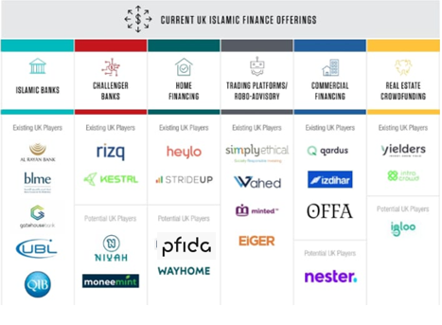
Double Financial Exclusion effecting Muslims in UK
Total number of Muslims in UK 4.1million (2023)
Approximately 50% of the 4.1 million Muslims can be classed as poor earning less than 60% of median income of £29k (2019)
Muslims have lost their jobs at six times the rate of the national total during pandemic (33% frontline vital services)
150-200 thousand from the Muslims(>10%) population do not have a bank account –FCA
Muslim have are the lowest percentage of people aged 16 to 64 years in employment 51% compared 70% (from all other groups)
Notes:
So how has this effected Muslims in the Uk?...
The Islamic finance sector operates under legislation that applies to all institutions withing the sector – enabling a level playing field for both Islamic and conventional financial products.
But much like the same way the government has in the past catered for the needs for larger institutional financial providers and curtailing its efforts with the mainstream financial inclusion sub sector, (Raised eyebrows) the Islamic finance sector has observed a similar disjointed effort in addressing the rising issue of financial exclusion affecting Muslims in the UK.
There is no mainstream financial service provider that focuses its efforts for the low income, financially excluded muslim community …simply put the risks are too high and returns are not economically viable which has also often been the argument in the conventional narrative.
4.1 million muslims in the UK
Approximately 50% of the 4.1 million Muslims can be classed as poor earning less than 60% of median income of £29k (2019)
When looking at job loss during the Pandemic, Muslims have lost their jobs at six times the rate of the national total –
33% of Muslims are employed in front vital services.
Almost 200 thousand Muslims in the UK do not have basic bank accounts,
Muslims also face unemployment issues – 51% compared to 70%.
The economic inequalities are indeed prevalent especially when considering that Muslims effected by exclusion are twice over excluded since, they are reluctant to use conventional microfinance services due to their interest bearing characteristics and given that there isn't much of an alternative that meets there needs,
therefore there is a significant likelihood of exasperating the phenomena self exclusion.
Apologies in advance for using the image on the right - I know its out of date – but the purpose was to illustrate the growing Islamic finance eco system in the UK and perhaps suggesting the notion of another column that represents (with all intents and purposes) an Islamic microfinance category for the underserved, underinvested markets.

Slide 8
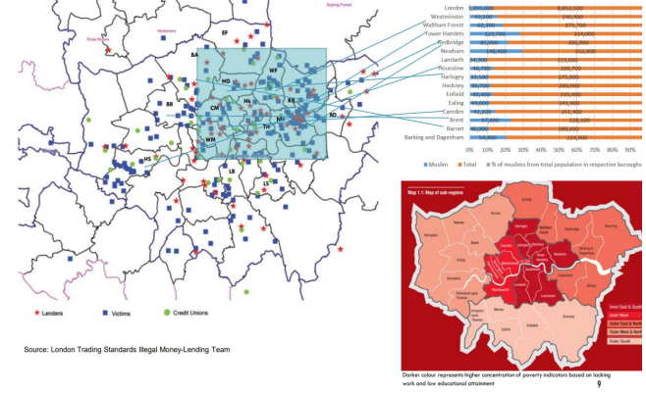
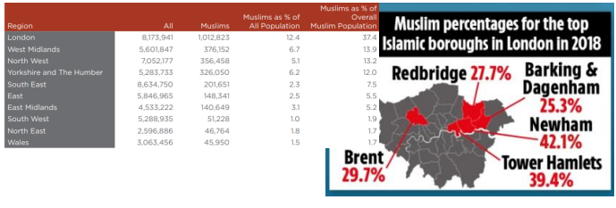
Growing concerns facing Muslims in London
When cross-referencing the highest concentration levels of poverty against the highest levels of crime linked to illegal lending practises, it is evident that cases are more prevalent in the inner London boroughs which ominously has the highest concentration levels of BME groups and Muslim communities.
Muslims have the highest unemployment rate amongst religious groups
68% of Muslims live in areas of high unemployment
51% (16-64) living in England and Wales are unemployed
Notes:
In analysing some of the existing financial exclusion data a concerning trend appears when information from different reports is correlated and cross referenced against the different data sets.
When comparing the highest concentration levels of poverty against has the highest levels of crime linked to illegal lending practises, it is evident that numbers are more prevalent in the inner London boroughs as highlighted in the figure below which ominously has the highest concentration levels of BME groups and Muslim communities as illustrated in the image on the left.

Slide 9
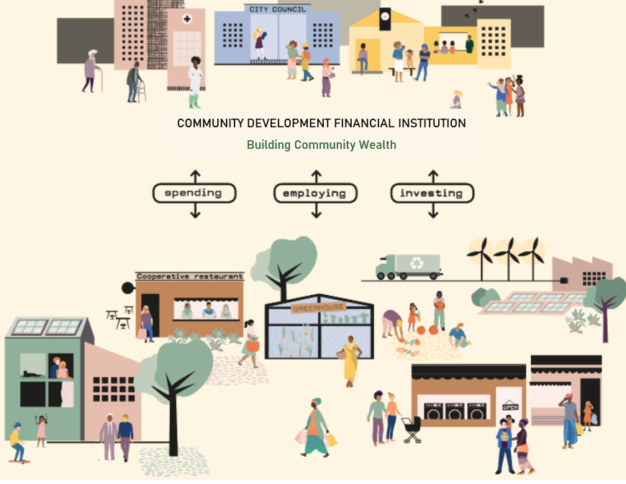
Community Development Financial Institutions (CDFI)
Wide variety of funding options and Government policy tools for attacking investors SITR/CITR
pp 32
Only 60 CDFI in UK
Personal Loans (Qard)
Home improvement lending
Micro enterprise loan
debt consolidation loans
Non Financial services
Ability to offer wide diversity of products /microfinance services
Main Concern around sustainability!
Wide support network CDFA/RF
Typically not for profit money lenders
Notes:
So we have so far looked at the definition and characterisation of Financial inclusion;
We have looked at Financial inclusion in the UK and its effects on communities, with a particular focus on the muslim population,
We have also highlighted one form of intervention being microfinance/Islamic and its need…but how is microfinance offered in practice that can exclusively channels its products and services to the financially excluded marginalised communities… well the answer is CDFI’s
CDFI as its suggests in its name - channels finance in the communities to support its development
CDFIs are specialised financial institutions that provide credit and technical assistance, therefore filling the gap for individuals and enterprises accessing finance, and providing opportunity to the underserved, underinvested markets.
There are currently 60 CDFI’s Across UK – very small number if you think about it – why?
They are usually not for profit money lenders – goal is to develop communities as well as being sustainable themselves.
Primary objective is to help low income families falling into a debt cycle through high cost loans/ illegal lenders.
Enabling communities to develop their lives – helping business start and grow
creating jobs for local people, or by supporting other social enterprises to increase their service to the community - Digital /social Exclusion.
Islamic CDFI’s

Slide 10
Summary Conclusion
Financial inclusion is a critical issue that has the potential to drive economic growth, reduce poverty, and promote social equality.
The need for Islamic Microfinance in the UK to address the growing concern of the financially excluded Muslim communities is critical.
Critical to ensure that whilst the Islamic finance industry grows, it doesn’t leave behind segments of the community who are unable to tap into the potential benefits of such products and services.
It is crucial to prioritise reaching excluded groups – indeed ‘reach’ is as important as the design of (shariah compliant) financial products.
Notes:
Conclusion - Financial inclusion is a critical issue that has the potential to drive economic growth, reduce poverty, and promote social equality.
Achieving universal financial inclusion is a challenging task that requires a multifaceted approach involving legislative support, community engagement, and the expansion of tailored financial services but with right initiatives, it is possible to provide a fairer access to financial services for the underserved markets.
The need for Islamic Microfinance in the UK to address the growing concern of the financially excluded Muslim communities is critical.
The UK’s position as a global hub of Islamic finance in the western world should be fully subjugated to ensure that whilst the Islamic finance industry grows, it doesn’t leave behind segments of the community who are unable to tap into the potential benefits of such products and services,
It is crucial to prioritise reaching excluded groups – indeed ‘reach’ is as important as the design of (shariah compliant) financial products.
The responsibility to develop meaningful and sustainable intervention should be structurally supported and prioritised by the varying stakeholders within the Islamic finance eco system and wider interested parties so that all can reap from the befits of its demand and growth.
Understanding and recognising the financial exclusion needs of the underserved community should also be priority to proactively develop and support.

Slide 11
Thank you q&A
Notes:
Thank you for some time and I hope that the presentation has helped shed some light on FI in UK.

